Slide 1
Sprint 0.1 Presentation
Golf Player Time Manager
Alyssa Beeker, Bailey Carlin, Daniel Teel, Elijah Hunt, Adam Horle

Slide 2
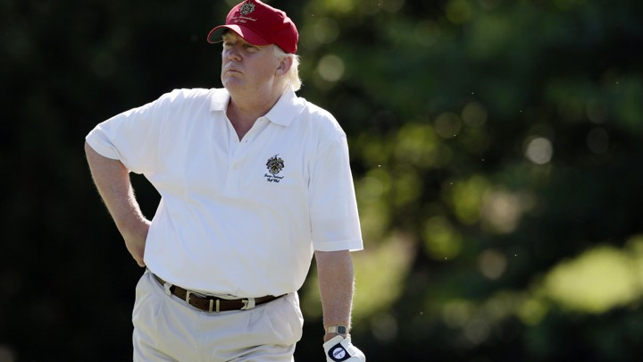
Problem Statement
There’s nothing more frustrating than playing a godly round of golf and having your momentum being thrown off by having to wait to play a hole because a player is taking forever. Our app, Golf Player Time Manager, seeks to alleviate this issue. With our app, players will be able to see the wait times for other holes and can be prepared to adjust play relative to other players. Requests can be sent to pass holes and notifications will be delivered to prompt slow players to allow other players to play before them or speed up their own play.

Slide 3
Project Vision and Definition
Project 1
Golf Player Time Manager (GPTM)
Two Components
Cloud based player management application.
Tracks which holes users are currently at
Calculates wait time predictions based on other users rate of play
User authentication
Mobile application
Users “check in” to a golf course to begin tracking
A list will appear that will update and display wait times
Users can request to skip to a certain hole, view history, and receive notifications

Slide 4

Cloud Component
Track players position on a virtual golf course utilizing an application on the players phones that transmits GPS location information
It will utilize AI queuing algorithm to optimize playing time by calculating wait times, playing speed and send messages to players to advise of playing time and the need to allow players to play through
Players devices application will be able to notify cloud applications for services or assistance
Provide helpful hints about the course based on the location of the player
System shall allow players to login and register their device
System shall monitor player behavior and provide player dashboard

Slide 5
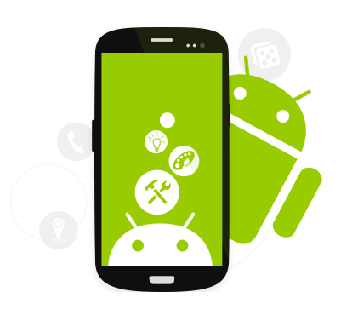
Mobile App Component
Downloadable application from standard stores
Players login and register at golf ranges
Players enables GPS and secure connection with cloud based app
Players app displays progress on the course, playing time, Warnings about playing speed, and request to allow playthrough.
Players app displays helpful hints based on location, and allows for notification to the cloud for services and assistance.
Players app display player history and dashboard

Slide 6
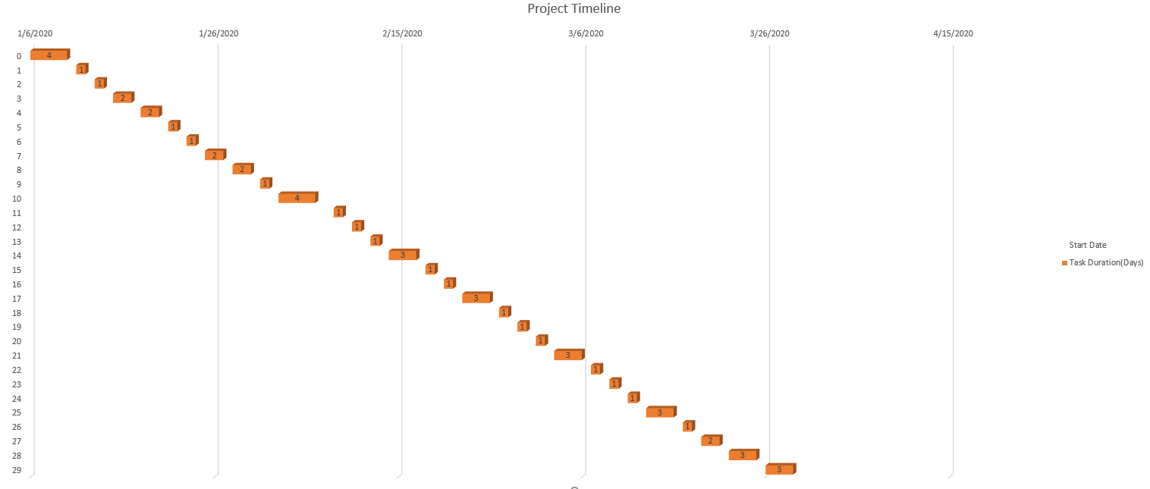
Project plan

Slide 7
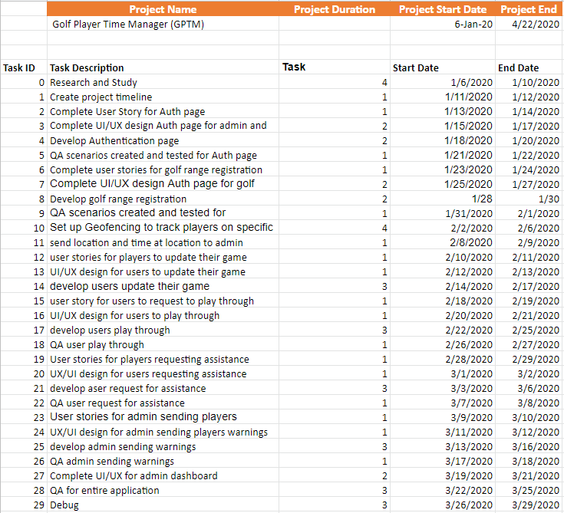
Project Plan
Spreadsheet created to account for all tasks

Slide 8
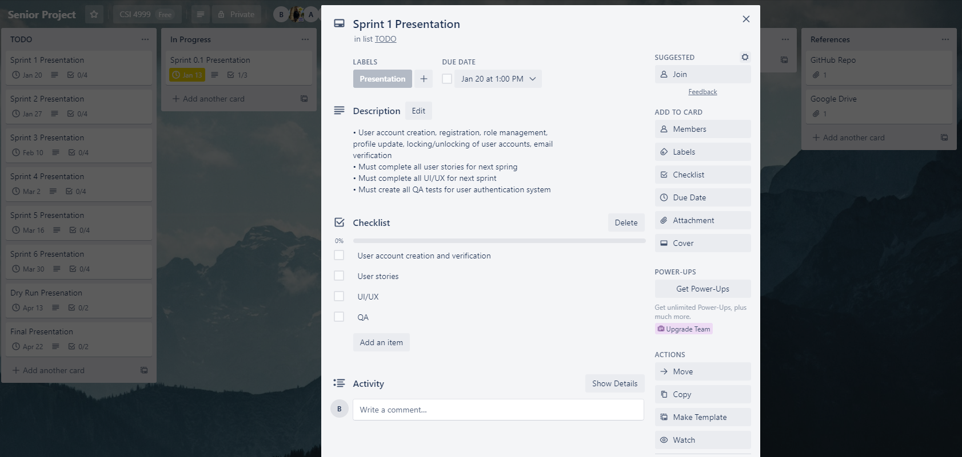
Project Plan - Trello
We will be utilizing Trello to keep team members on top of tasks

Slide 9
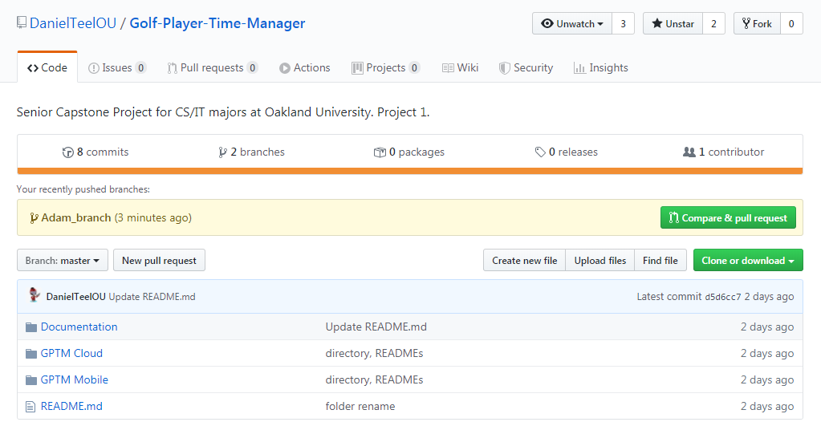
Project Plan - Github
Github has been created for the project
Team members got the opportunity to test using github and prepare branches for Sprint 1

Slide 10
Technical Details
Language
Java
AI
Tensorflow lite
GPS
Smart Location
Google Maps API
Database
SQLite, Firebase
Sign-in
Built in SDK using Google account
IDE
Mobile App: Android Studio
Cloud App: any IDE or text editor
Design
Visio
Collaboration
Github
Google Drive
Trello

Slide 11

Risks and Challenges
Inexperience with:
Android Studio
GPS tracking
Unsure about:
AI queuing algorithms
Golf
Time management
Planning and prioritizing around everyone's schedules.

Slide 12
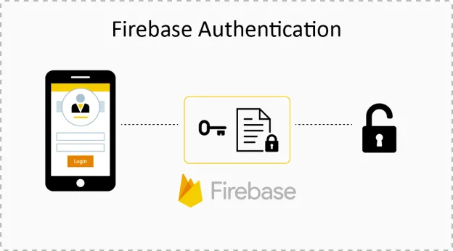
Next Sprint Objectives
Connect our application to firebase
Authentication
Create user stories
Design UI/UX
Develop
Test

Slide 13
QUESTIONS?

